Slide 1



Aims & Objectives…
* Aid transition to the College
* Support lost learning as a result of the pandemic
* Build early relationships with staff
* Alleviate fears and anxieties
* Have fun and try new activities

Slide 2
Feedback…
Honestly, the summer school has been a welcomed distraction for my son after the events of the past year. He comes home full of joy and chatting about his day. Thank you so much for giving the children this wonderful experience to adapt to their new school
It’s been amazing. Oliver has loved attending, so much so he came back for week 2. Thank you for making such a good impression and making him feel welcome. He’s really enjoyed the music and sports and he had the opportunity to play guitar which he wants to continue in September. Thank again. Faultless.
It was great as it was. Excellent start for Layla. I believe that she will be more confident and less anxious about starting in August. Thank you to all involved!
Harrison has loved his week at Summer School! He’s come home buzzing everyday about all the new sports he’s been able to try as well as playing the drums, guitar and keyboards. The week has really alleviated any worries he had as well as being informative and fun. Massive thank you to all the staff involved.

Slide 3
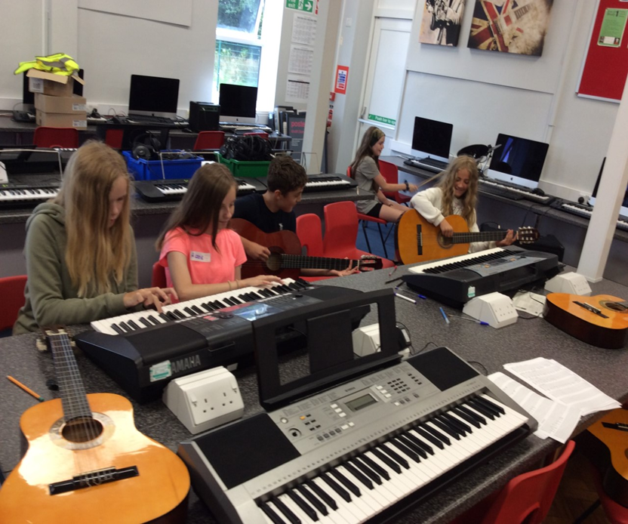
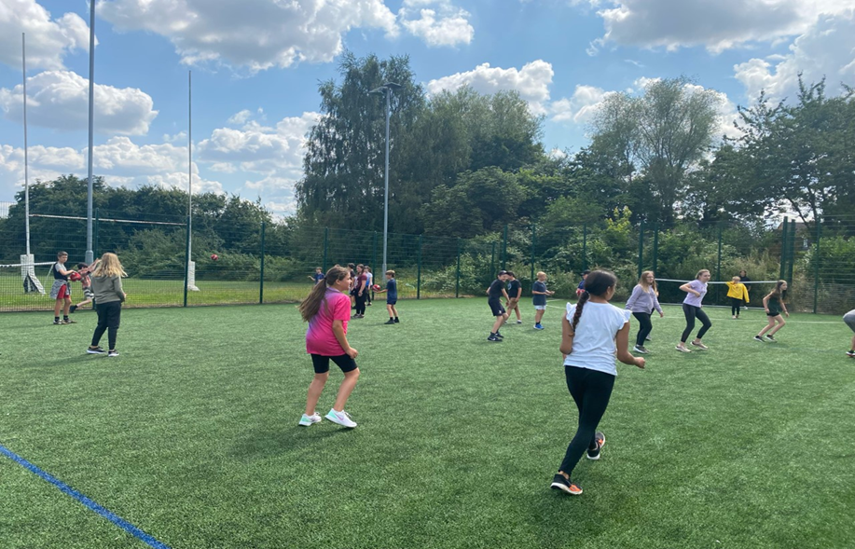
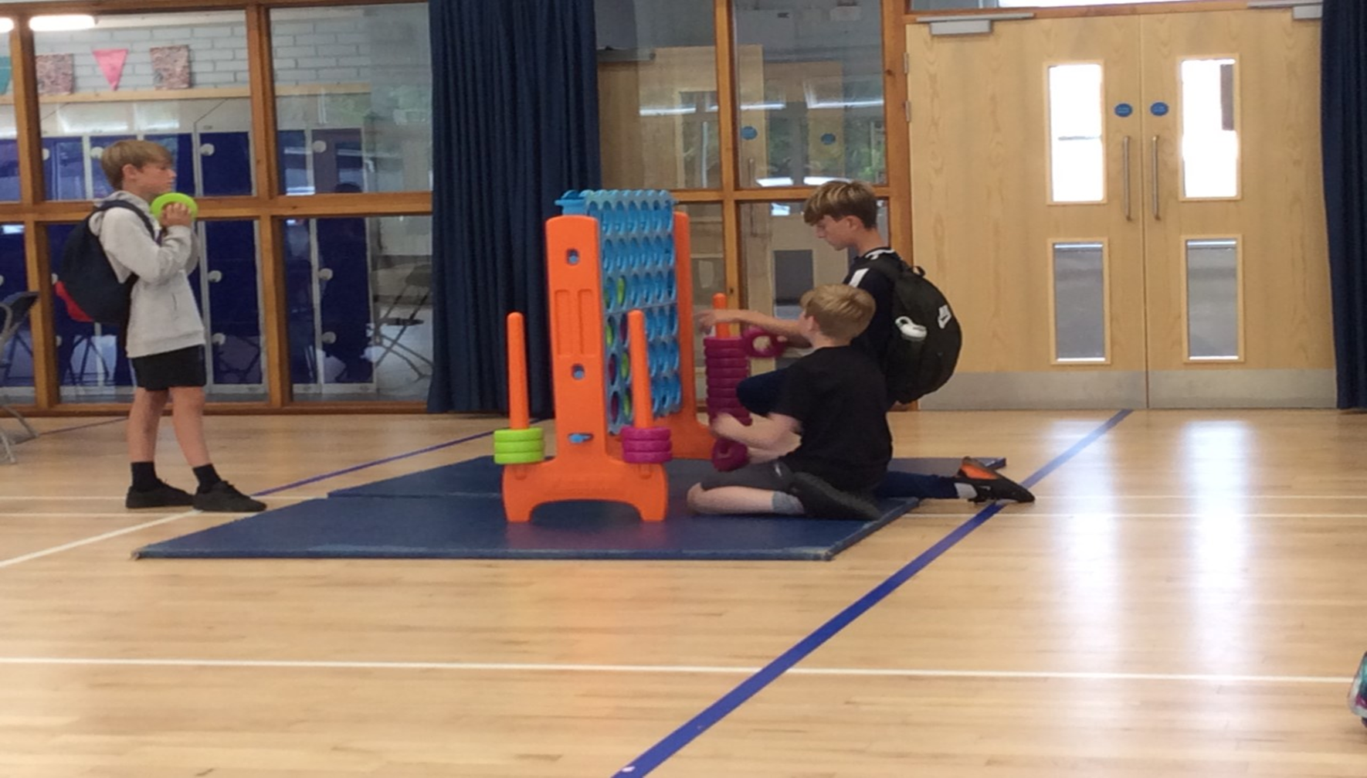
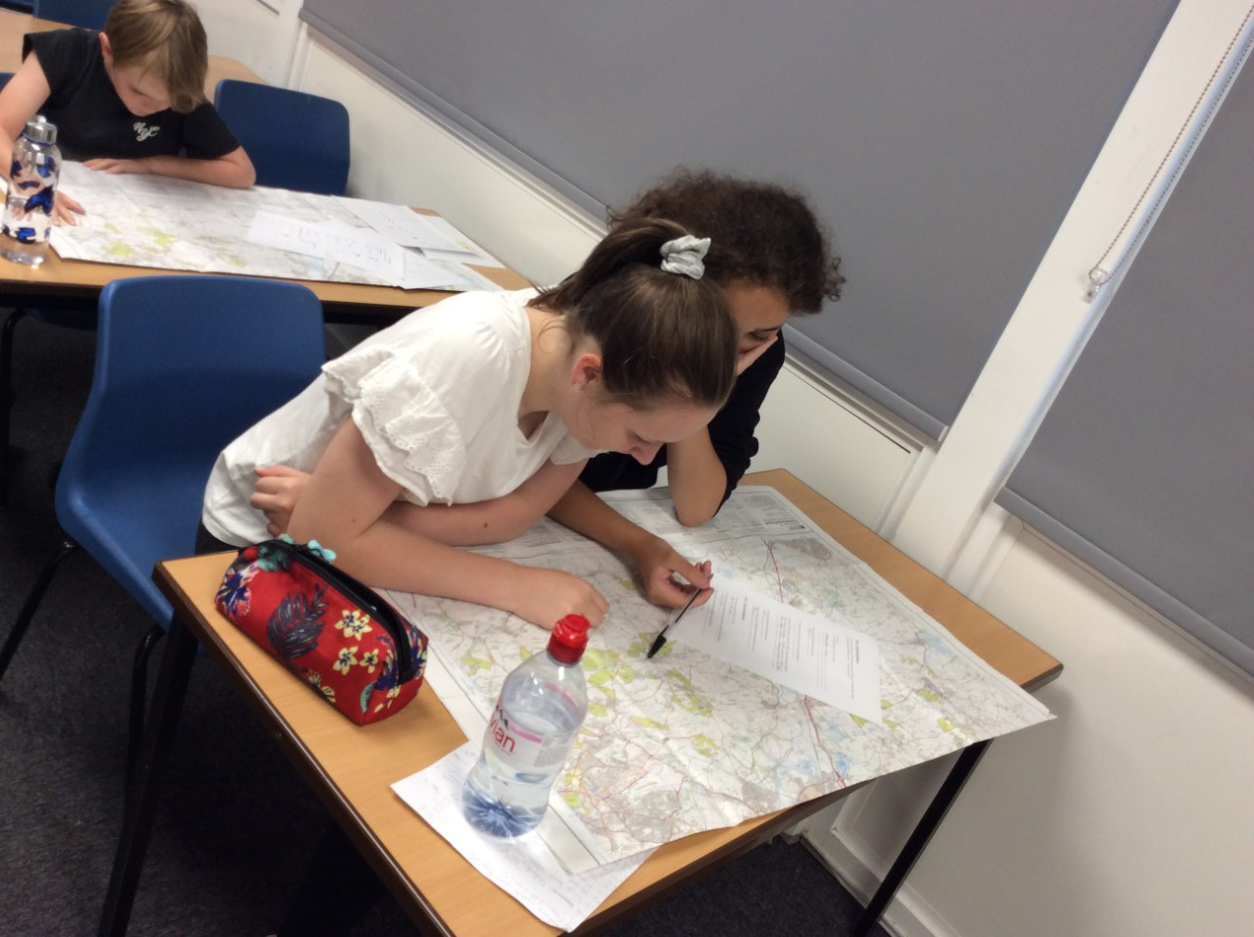

Slide 4


